Slide 1
V6 Backup and Restore
Protecting Data in the ENOVIA V6 Environment

Slide 2
Owner and Revision History
Owners: Olivier Dechoux (DS), Michael Finocchiaro (IBM)
Contributors: Bruno Moisant (DS)
Revision History:
Version | Modifier | Comments | TBD
1.0 | Fino | Creation | Add content

Slide 3
Learning Objectives
At the end of this module, you should be able to:
Describe the best practices for data placement in ENOVIA V6
Describe the backup procedures for ENOVIA V6
Describe the main scenarios for failure and the associated recovery procedure

Slide 4
Contents
Data Placement and Backup
Backup Procedures
Cold
Hot
Failure Scenarios and Data Restoration
Loss of the Central Database (DB)
Loss of the Central Data Store (FCS)
Loss of a Remote FCS
Loss of an Autonomy IDOL Server
Loss of a 3D Index Server
Recovery and Verification Tools

Slide 5
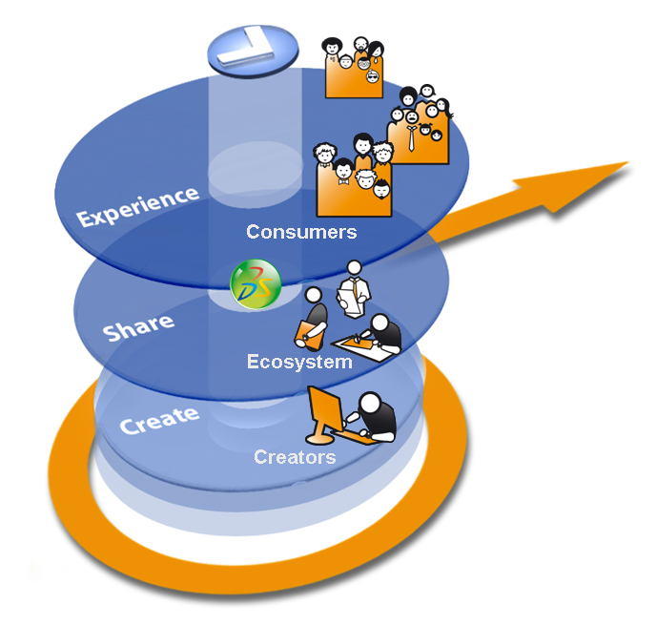
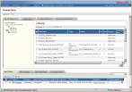
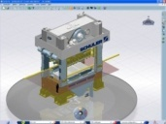






V6 Multi-Tier Architecture Principle
Web Clients Ex.: ENOVIA business process applications
Presentation
Light Visualization Clients Ex.: ENOVIA 3DLive
Workstation Clients Ex.: CATIA V6, DELMIA V6, SIMULIA V6, xCAD…
Clients
DATA ZONE OF PRIMARY INTEREST FOR BACK AND RESTORE
HTTP
A
Logic
Applications Server(s) (MCS)
Index Servers Indexing Repositories
S
F
File Server(s) (FCS) Representation and Content Repository
Data
D
(*) Optional.
Database Server: Metadata Repository
Notes:
Data Tier
- Database Server Role: Storage of meta data i.e. “data about data”.
- Search Server
Role: Index meta data and files for key word searching and refinement.
- File Server called in ENOVIA “File Collaboration Server” or FCS / STORE
Role: Rapid storage and retrieval of representations (like CAD geometry for instance).
Physical view: Application Server + File server w/ FCS applications installed – the application server being limited to transfer files for the file server to the client seat.
Logic Tier
- Application Server called in ENOVIA “Main Collaboration Server” or (MCS) / RDBMS
Role: Handle the business logic and data access of the applications.
Physical view: Application Server w/ MCS applications installed
- Web Server(s) Role: Accept HTTP requests from web clients and serve them HTTP responses along with optional static contents (web pages, style sheets, java scripts, etc.).
Can be also used as a proxy/load balancing server.

Slide 6


V6 Data Types – What Needs to be Backed-Up
PLM Metadata – requires Hot or Cold Database Backup
PLM Content – requires Hot or Cold Backup Synchronized with the Database backup
PLM Indexes – can be dissociated from the first two but still requires non-negligible time to rebuild if lost
Database Server
File Server
Index Servers
Metadata
Content
Indexes
3D Rep
3D Index
PLM Object A.1
PLM Object A.2
3D Stream
PLM Object B.1
PLM1.doc
Indexes
PLM2.pdf
AdvancedSearch Index
Notes:
6
The data model for V6 is a completely new departurefrom how thingsweredone for V4 and V5. The file-basedmethod of getting to content has been deprecated and now all content isstoredcentrally in ENOVIA V6. The threekinds of data are:
Metadata – objects, links, relationships, workflow, etc all stored in a database
Content – streams and reps for 3D data and all othertextual data (PDFs, Office documents, etc.)
Indexes – index servers for rapidaccess to bothtextual and 3D content
PLM Objects as Metadata
Located in Database server
Unique repository of PLM information
Metadata only accessible via Master Collaboration Server
PLM Objects point directly to stream within Store Server
Long Data
Core PLM data
PLM representation as Streams
PLM representations = CGR, Nav Rep, Shape, ...
Index data
Optional 3D research capability for improved performance

Slide 7
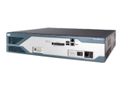






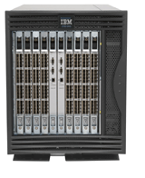
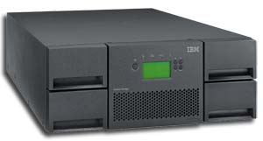
Example of servers and attached storage
The Database, FCS, 3D Index Servers, the IDOL Server, and Domino all write volatile data to a disk
This data can be backed-up from a common SAN using a tape device
A LUN is a Logical UNit on a storage bay (i.e. one or many physical disks)
Firewalled Router
MCS
3DNDX- BLD
3DNDX- RT
IDOL
CONF
DB
FCS
Fiber Switch
LUN for DB
LUN for STORE
Storage Bay / SAN
LUN for 3D Indexes
LUN for IDOL Indexes
…
LUN for Domino
Backup Tape Library

Slide 8
Location of Data Files for Backup
Ideally, we would like all content to be centrally located on a secured data storage unit such as a SAN. Here are the data types and where the data location is defined
Application | Data Type | Location | Example(s)
Database | Datafiles, redo logs | Defined at database creation time | /Data/Database/ENOVIA –or- F:\Data\Database\ENOVIA
FCS | 3D Reps, 3D Streams, Content files (PDF, .doc, .ppt, .xls, etc.) | Defined by LOCATION in System application of StudioModeling and LiveCollaborationServer | /Data/Store/EVP –or- F:\Data\Store\EVP
3D Indexes | Indexes for 3D Data | Defined by the PLMIndexAdmin Tool at Build-Time | /Data/3DIndexes -or- F:\Data\Store\3DIndexes
IDOL Indexes | Indexes for PLM Data in the system (both Metadata and all content) | Defined by the directories agentstore, category, content and indextasks (can by symlinked to a SAN or NAS) | /Data/Autonomy/IDOL -or- F:\Data\Autonomy\IDOL
Domino/Sametime | Domino Directory and Sametime config | Defined during Domino Installation | /Data/Domino –or- F:\Data\Domino
ActiveDirectory/OCS | ActiveDirectory LDAP Repository | Defined during Active Directory Installation | F:\Microsoft\AD2003

Slide 9
Note about Remote FCS Stores
Remote FCS Stores present a non-negligible problem for backup and restore
Two scenarios:
Default behavior: Latest versions could be on the remote FCS or on the Master FCS. All need to be backed up simultaneously to get an accurate picture of all stored content referred to by the metadata in the database.
Disadvantage: often not realistic given overlapping work time zones
New optional behavior: Latest versions always are synced to the FCS before transfer to another FCS. The process is described in detail on the following slide
Disadvantage: latest versions that have not be requested for synchronization either to the master FCS or another remote FCS are not included in the backup of the master FCS and will need to be backed up locally

Slide 10


Synchronization mechanism with VPM Application
By default in V2009x, all synchronization goes directly from FCS to FCS without necessarily passing through the MCS. To change this behavior:
Activation of JPO from VPM app suite with Environment variable in mxEnv.sh
MX_FCS_REPLICATE_PROGRAM_NAME=com.ds.utils.ReplicationCallBack
This means that all synchronizations will necessarily copy the data to the master FCS before transferring to another site/location.
Site 1
3. MCS determines which FCS has the latest version
Site 3
3
3
Central site
4. Copy the latest version from FCS to Central FCS
2
3
2. Ask to the MCS where the latest version is
5. Copy the latest version from Central FCS to FCS
1. Need to get the Green object
Site 2
3
1

Slide 11
Backup Scenarios
Application Binaries on Local Machines and Data on Local Machines
Need to put backup agents on each of the machines and schedule cold backups on each simultaneously
Application Binaries on Local Machines and Data on Storage Bay
Need to make periodic backups of the Application Binaries and clean up log files once a month for example – this will necessitate stopping all services on the servers until backup is complete
Need to backup the storage bay via snapshots – can be done with both hot and cold backups. For hot backups using snapshots, this can be done without application shutdown
Application Binaries and Data on Storage Bay
Need to backup the storage bay via snapshots – can be done with both hot and cold backups. For hot backups using snapshots, this can be done without application shutdown

Slide 12

Performing a “Cold” Backup
Cold Backup means that you have protection of the entire database as it is made with the database in a ‘closed’ and consistent state.
Perform backup initially to another disk for speed, later to tape for security.
Always keep previous backup available on disk until the current backup has completed successfully.
Backup Database files and Master FCS simultaneously.
Remove archive log files to make space for new files.
Move previous backup to off-site storage media.

Slide 13
Cold Backup Example
The modification impact only the metadata .So the metadata and her URL link are updated
Data evolution
database
Metadata server
URL
Link
The modification impacts the set of data linked between them. So whole of the data and their URL Links are updated
Data evolution
FCS Store
URL
Link
Indexes
Data evolution
Index server
t1
t2
t3
Time
The data are always up to date between them from a database to another, at any time
In a Production environment, the databases work together, and so their data are linked between them and evolve together
Rule : the backup must respect the data synchronisation between databases and repositories

Slide 14
Cold Backup Example
Back up
STOP
Restart
Data evolution
database
Metadata server
Back up
STOP
Restart
Data evolution
FCS Store
Back up
Indexes
STOP
Restart
Data evolution
Index Server
t1
t2
t3
Time
Backup principle
A complete production environment stopping (main and remote sites) is performed
The redo logs are not archived
Then the save procedure is launched
Each database and vault is saved through a compressed file
As the databases are simultaneously stopped, they are all in a coherent state between them. So the resulting database, vault database (and repository) backups are synchronized
Advantages
A safety image of the complete environment at a given time
The databases and Vaults data are synchronized
Disadvantages :
The complete environment must be stopped
The databases and vaults modifications (data, instructions…) after the last backup are not saved until the next backup. So In case of database crash, the data lost can be important

Slide 15
Restore offline
Backups have been made at t1
The different backups are restored and the databases are restarted
Back up
A crash occurred.
Databases and vault are stopped
Back up
Restart
Data evolution
database
Metadata server
Back up
Back up
STOP
Data evolution
Vault database 1
Restart
Back up
Back up
STOP
Data evolution
Indexes
Restart
Index server
t1
t2
t3
t4
t5
tx
Time
At tx, the environment is in the same state than at the moment t1
Restoration procedure
All the environment is stopped
From the backups offline files, all databases and vaults are unloaded
After restoration :
All databases and vaults are consistent and synchronized between them
The rebuilt environment is in the state at the time of the backup
All data, instructions performed after this backup are definitely lost
Due to the important data lost potential, this restoration is rarely used except in case of :
main crash of company or new environment to set-up

Slide 16
“Hot” Backup
Permits 24 x 7 database utilization
For Oracle, this must be made with the database running in ARCHIVELOG mode ( a MUST for recovery)
Database is open, users are working
Writing from the Redo log files to archive files
Hot backups do not copy the redo log files since they are being archived and backed up with nightly backups
Only the Datafiles are backed up
Stores and FCS stores must be backed up simultaneously to assure consistency of metadata and content

Slide 17
Alternative Method - Snapshots
If all the data is on a storage bay, most of these bays have a snapshot capability
The snapshot takes a mirrored copy of the LUN(s) off-line and backs it up
The on-line copy is still used by the active users so no downtime is required
Once the snapshot is complete, the off-line copy is mirrored back to the on-line copy and production continues

Slide 18

Restore Scenarios - Database
Full restore (Disaster recovery)
Both Database and Store backups of the same day must be restored
Partial restore (human error)
Database backup must be restored on a dedicated server
Identify Data to restore and run 3DXML Export on the selected data
Any missing Store file will cause an error
Exact file path are provided for each
Restore missing store files from Store backup
Run 3DXML Export again (successful this time)
Import this 3DXML in Product Database

Slide 19
Restore Scenarios – Master FCS Store
Full restore (Disaster recovery)
Both Database and Store backups of the same day must be restored
Partial restore (human error)
Database backup must be restored on a dedicated server
Identify Data to restore and run 3DXML Export on the selected data
Any missing Store file will cause an error
Exact file path are provided for each
Restore missing store files from Store backup
Run 3DXML Export again (successful this time)
Import this 3DXML in Product Database

Slide 20
Find Orphaned Files in the FCS Store
List the Store Contents of the Store PLMX (as seen by the metadata in the database)
MQL> inventory store plmx
To identify the files present in the filesystem of the store but not in the metadata:
1) In the directory of the FCS Store :
OS Command to list files in the PATH of the store
(ex, UNIX) > find . –type f –print > /tmp/list_files
2) Validate the contents:
MQL > validate store plmx file /tmp/list_files
3) The list of orphaned files will be in /tmp/list_files.out
4) Delete all the files in /tmp/list_files
Note: if the store is cmposted of many locations, you must execute step 2 appending to the /tmp/list_files file on each of the location servers
Ex. on Location 1, find . –type f –print >> /tmp/list_files

Slide 21
Restore Scenarios – IDOL Server
Full restore (Disaster recovery)
Restore the last backup
Partial restore (human error)
Restore the last backup and run a partial Index job using MQL

Slide 22
Restore Scenarios – 3D Index Server Disk
Full restore (Disaster recovery)
Restore the last backup
Partial restore (human error)
Restore the last backup and run a Incremental Index job using PLM Admin Tool

Slide 23
Restore Scenarios – Domino/Active Directory
Full restore (Disaster recovery)
Restore the last backup
Partial restore (human error)
Restore the last backup and manually check that all users defined in ENOVIA V6 P&O that need collaboration/conferencing support are defined in the LDAP Directory (either Domino or ActiveDirectory)

Slide 24
Recovery Tools
The 3DXML mechanism was discussed on slides 19
The MQL inventory process described on slide 20
Another tool is the VPMDataChecker (alternatively called the PLMDataChecker)
VPMDataChecker command enables to check/repair some consistency rules.
Here is a table describing the detected errors and the correction applied

Slide 25
Data Checker command
VPMDataChecker command must be executed on server side :
VPMDataChecker [–user user –password password -host serverURL –outputfile outputfile [[–mode {Check | CheckAndRepair}] | [-input reportingfile]]]| [-h]
User : User name. It must be an M1 administrator user with read access right on all data
Password : Password
ServerURL : URL of the ENOVIA V6 server
Outputfile : reporting file. Optional when the CheckAndRepair option is used
Mode : execution mode. Either ‘Check’ or ‘CheckAndRepair’
Reporting file : XML file coming from a previous execution of the tool. Using this option automatically selects a ‘Repair’ execution mode where all and only the errors contained in the file are repaired.

Slide 26
Data Checker results
Example of xml result file :
<?xml version="1.0" encoding="UTF-8" ?>
<ERROR_LIST>
<ERROR
NAME="ERR_AGGR_REP_NOINST"
PLMID="PLMIDv0(3786B14000000AD048F6008300013519,3786B14000000AD048F6008300013519,VPLMtyp/PLMRepresentationDS,PLM1)"
TYPE="PLMRepresentationDS"
PLM_ExternalID="CRN-XXXX_Plan ASS3"
V_version="---"
/>
</ERROR_LIST>
Note :
The correction and detection phases can be mixed or launched independently.
When launched independently, the correction step will take the detection xml file generated during the previous phase and will proceed to the necessary corrections. This step is atomic, that is to say all the corrections are done or none are implemented.
27/02/09
26

